Slide 1
Youtube Trending Videos
Group ID 08
Neha Jaju 33224
Shyamal Khachane 33227
Manvi Pandya 33235
Gauri Nandkhedkar 33239

Slide 2

INTRODUCTION
YouTube is the most popular and most used video platform in the world today.
We will analyze this data to get insights into YouTube trending videos, to see what is common between these videos.
Those insights might also be used by people who want to increase the popularity of their videos on YouTube.

Slide 3

MOTIVATION
It is interesting to know whether a video is popular is dependent on its category and the cultural background of viewers.
Analyze the composition and popularity associated with different factors of online videos on YouTube.
Shed light on how YouTubers are supposed to refine their videos to get more subscribers, and recommend popular channels of particular video genres.

Slide 4
DATASET
The dataset that we have used is obtained from Kaggle.
It contains data about trending videos for many countries. Here we will analyze a dataset containing 5 csv files and 5 json files(for 5 different countries).
The datasets that we have used are CAvideos.csv, DEvideos.csv, FRvideos.csv, GBvideos.csv, USvideos.csv and the corresponding json files too.
CAvideos.csv - Dataset for Canada
DEvideos.csv - Dataset for Germany
FRvideos.csv - Dataset for France
GBvideos.csv - Dataset for Great Britain
USvideos.csv - Dataset for USA
Link for the dataset : https://www.kaggle.com/datasnaek/youtube-new#CAvideos.csv

Slide 5
The datasets consists of the following attributes:
video_id - id of the video
trending_date - trending date of the video
title - title of the video
channel_title - name of the channel that has published the video
category_id - id of the category video falls under
publish_time - time at which the video was published
tags - tags added for the video
views - number of views the video has
9. likes - number of likes the video has
10. dislikes - number of dislikes the video has
11. comment_count - number of comments the video has
12. thumbnail_link - links to the thumbnail in the video
13. comments_disabled - TRUE/FALSE column indicating whether the comments are disabled
14. ratings_disabled - TRUE/FALSE column indicating whether the ratings are disabled
15. video_error_or_removed - TRUE/FALSE column indicating whether the video has error/is removed
16. description - description of the video

Slide 6
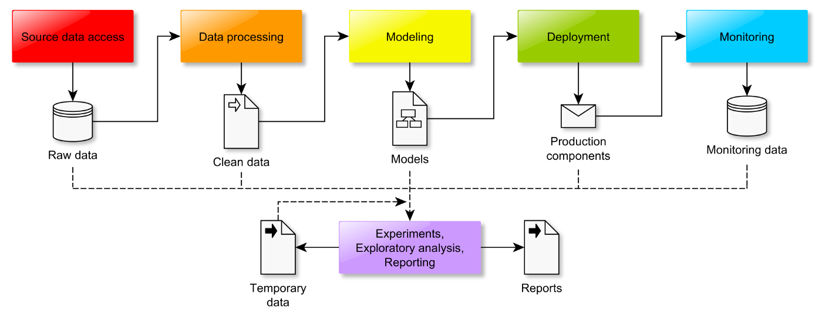
IMPLEMENTATION

Slide 7
DATA-PREPROCESSING
Removing all the infinite values.
Making comment_count 0 for those rows whose comment_disabled is TRUE.

Slide 8
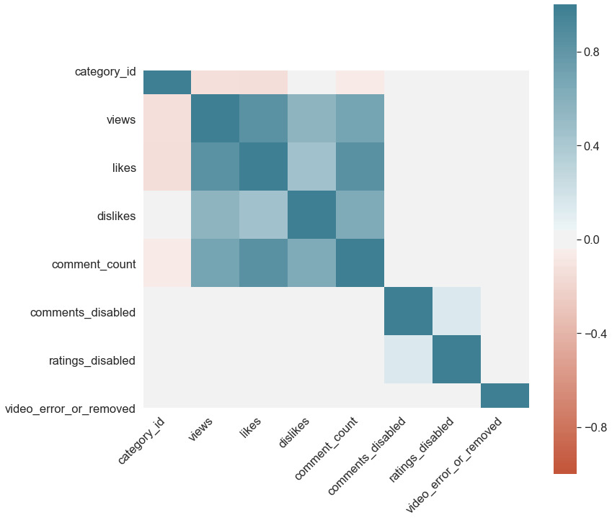
CORRELATION MATRIX

Slide 9
Visualisation
Most popular Video Category.
Maximum videos are published at what time.
People interaction with Youtubers
Approval Rate of video categories.
Most Controversial video category

Slide 10
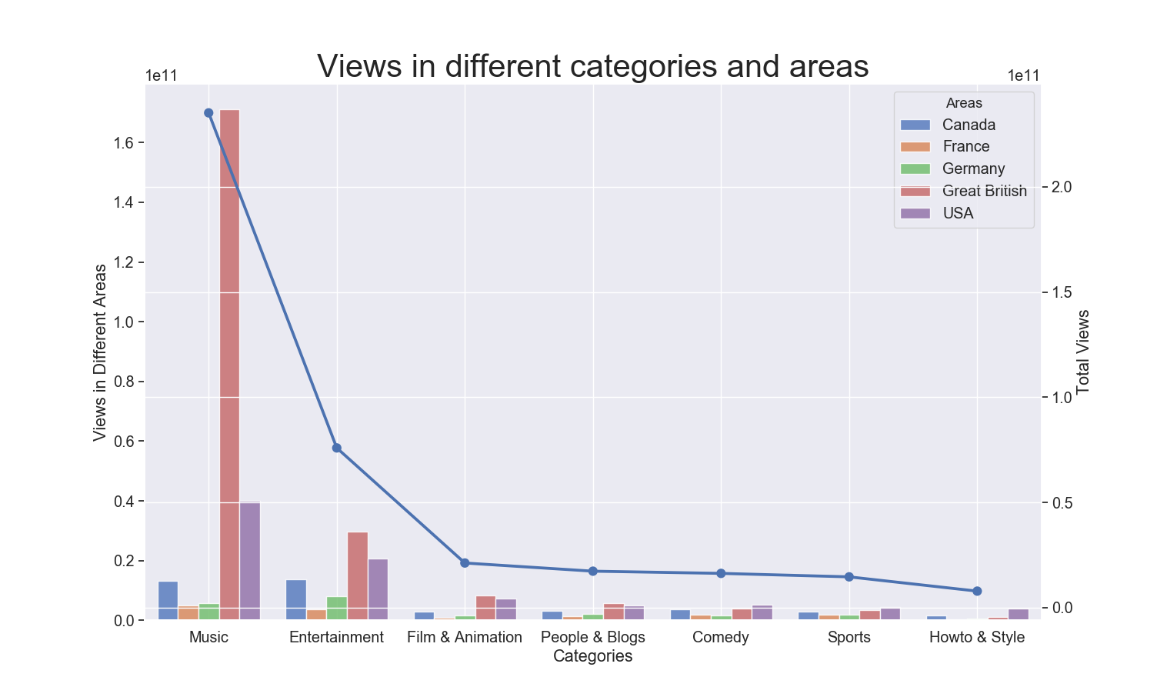
What category of videos is popular depending upon Views?

Slide 11
Observation:
On average,people irrespective of culture are highly interested in Music and then in Entertainment.
On contrary when we see individually,following are the results:
Canada -> Entertainment
France -> Music
Germany -> Entertainment
Great British -> Music
USA ->Music

Slide 12
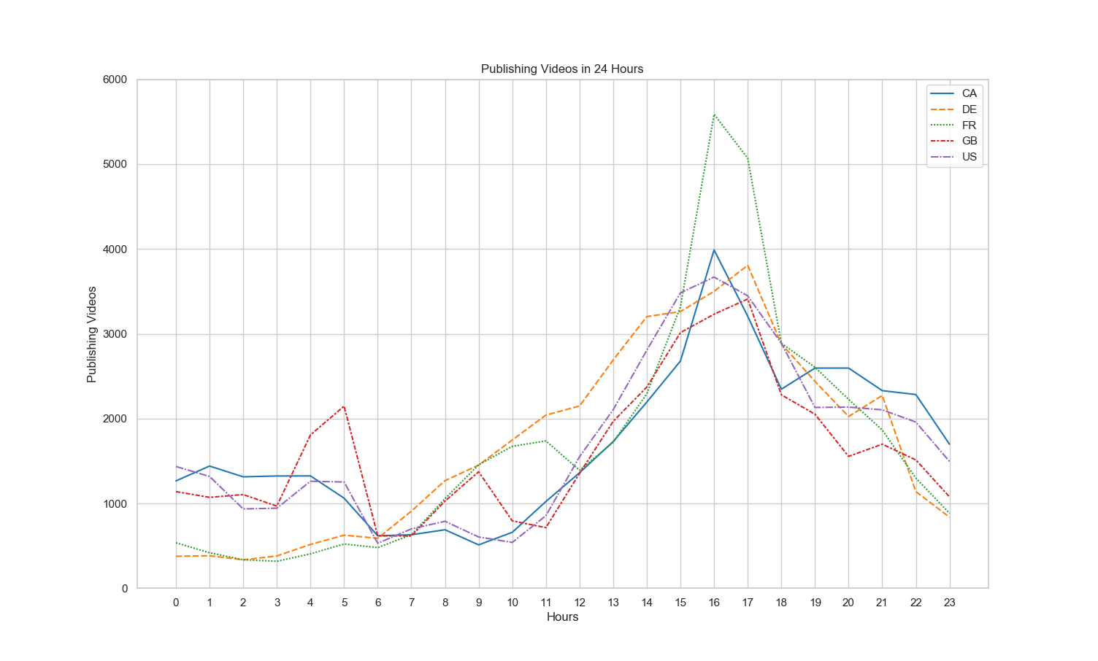
What is the fluctuation publishing videos in 24 Hours within 5 different area?

Slide 13
Observation:
This graph shows the best time to publish a video.
On average,it is between 4pm to 5pm. While on the other hand individually,it is as follows:
Canada -> 4pm
France -> 5pm
Germany -> 4pm
Great British -> 5pm
USA -> 4pm

Slide 14
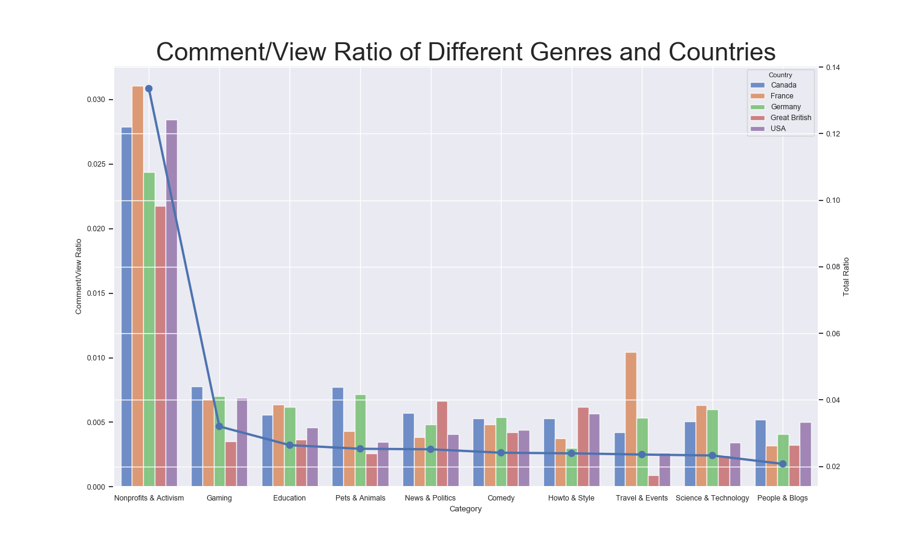
How many viewers tend to comment on the video?

Slide 15
Observation:
On average,Every 1 in 200 viewers writes down something under the video unless the video is related to Nonprofits & Activism ,the Comment/View Ratio of which is 2.5%.

Slide 16
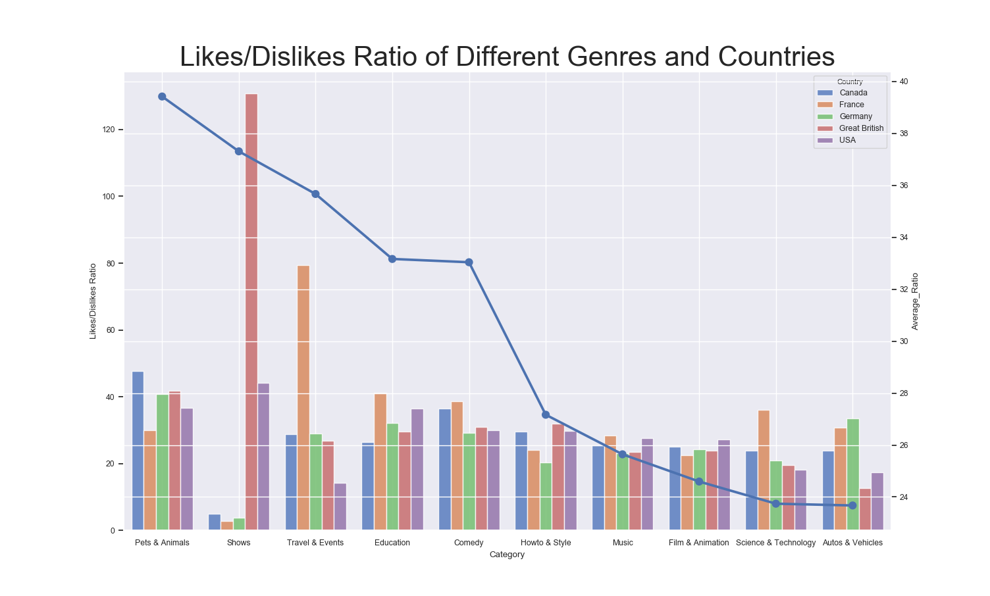
What kind of video is approved by the viewers?

Slide 17
Observation:
Ratio of likes and dislikes as an indicator of audience approval rating for the video content
The approval rate varies among different genres for popular videos.
Animal,Comedy and Education have the highest approval rate. Audience generally respond positively to these types of videos

Slide 18
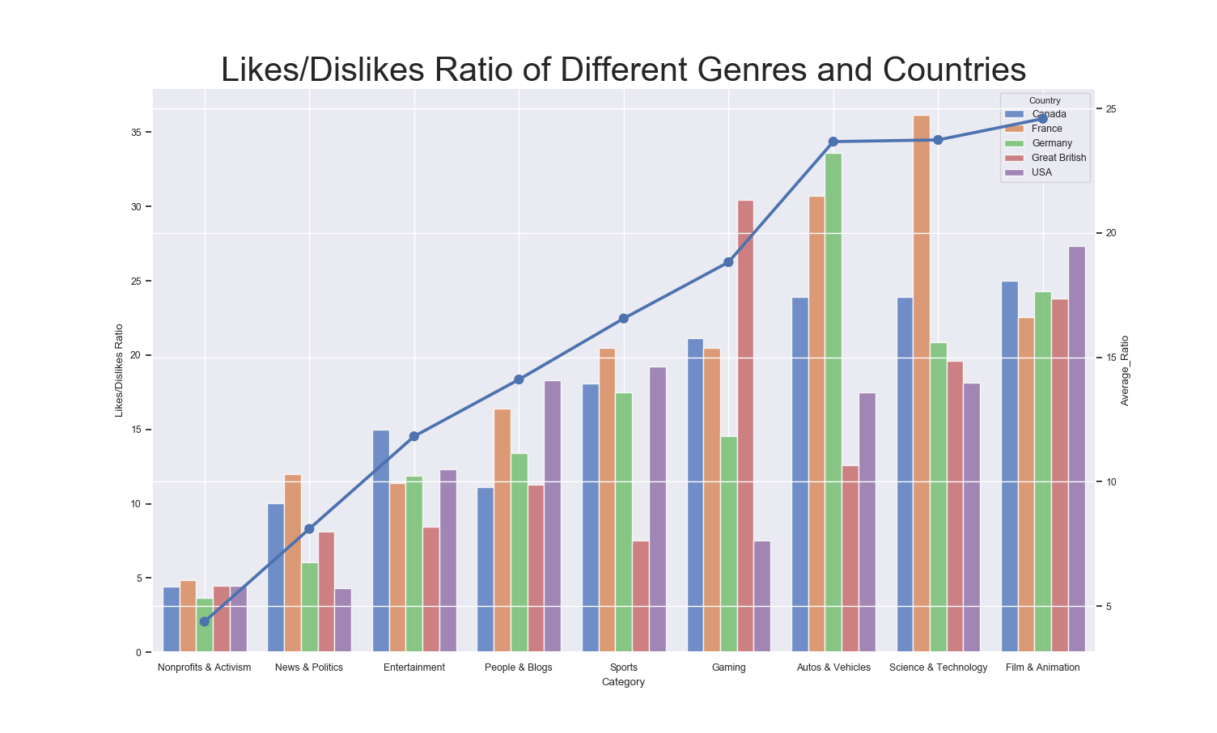
Which are the most controversial video categories?

Slide 19
Observation:
People tend to have divided opinions when viewing video of type News & Politics and Nonprofits & Activism
Nonprofits & Activism, News & Politics and Entertainment are the 3 most controversial topics.

Slide 20

PREDICTION
Views
Likes
No of comments

Slide 21
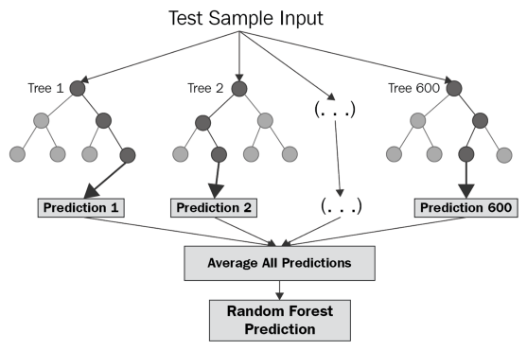
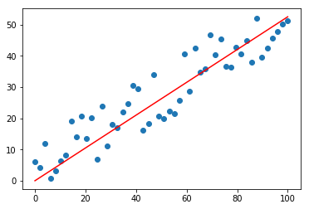
ALGORITHMS
Linear Regression
Random Forest Regression

Slide 22
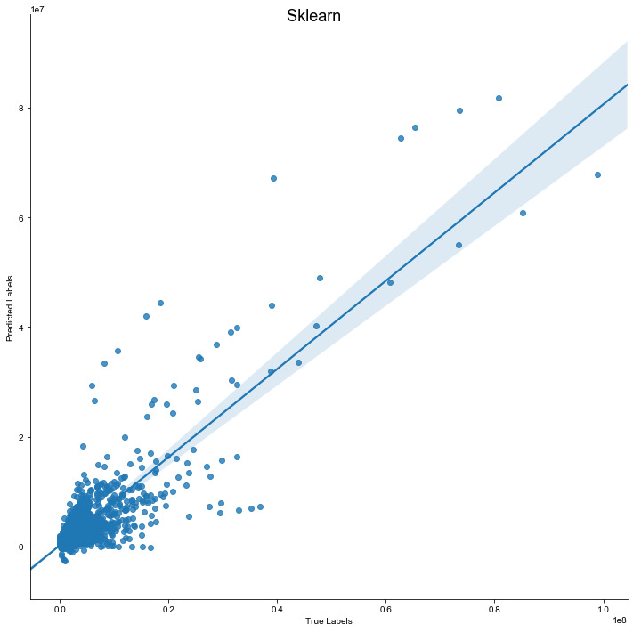
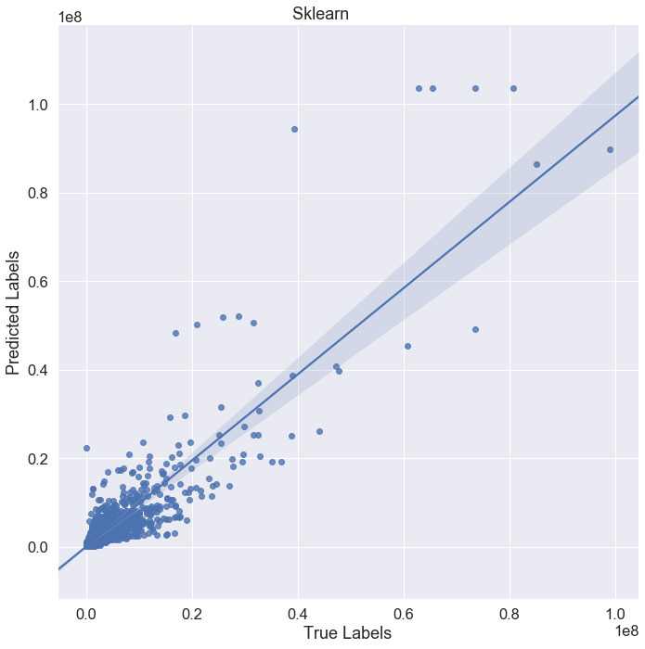
VIEWS
LINEAR REGRESSION
RANDOM FOREST

Slide 23
OBSERVATIONS
Model | Variance | Result
Linear Regression | 0.75 | 0.7542763267044565
Random Forest | 0.76 | 0.7609540643171527

Slide 24
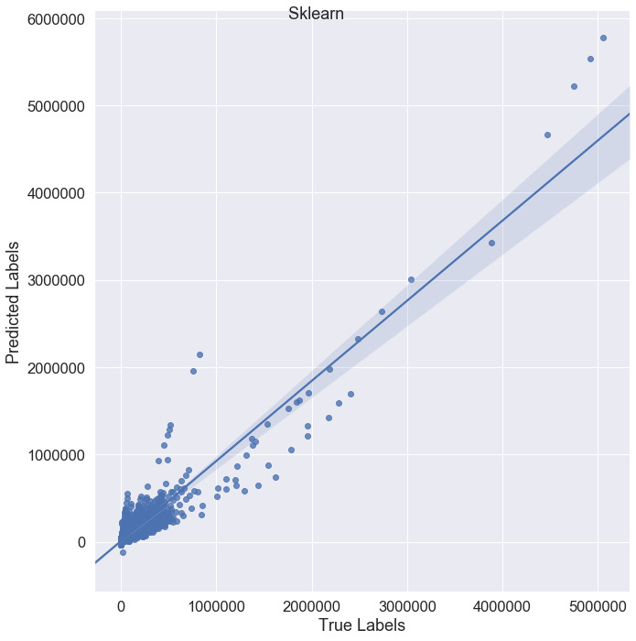
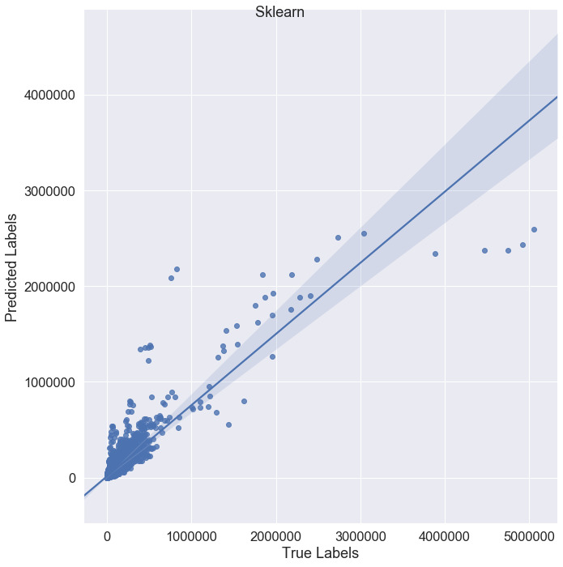
LIKES
LINEAR REGRESSION
RANDOM FOREST

Slide 25
OBSERVATIONS
Model | Variance | Result
Linear Regression | 0.89 | 0.8866375038045632
Random Forest | 0.80 | 0.799206894589727

Slide 26
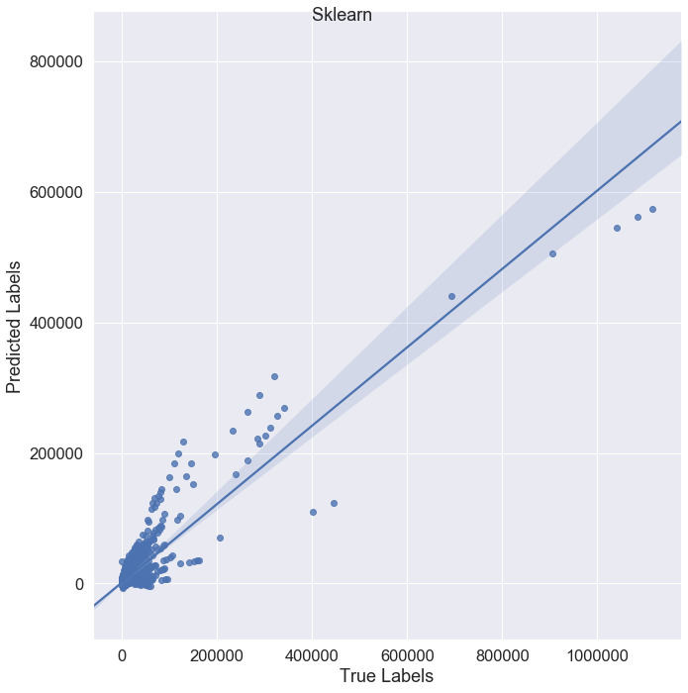
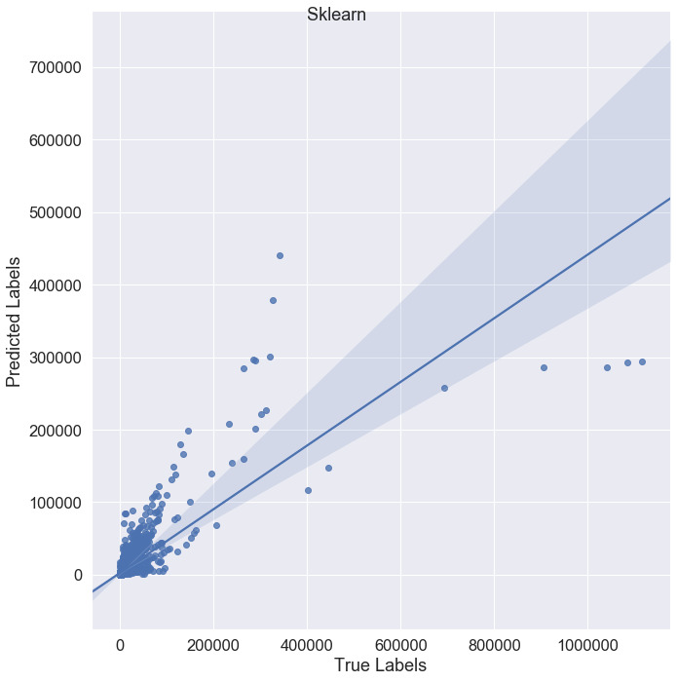
COMMENTS
LINEAR REGRESSION
RANDOM FOREST

Slide 27
OBSERVATIONS
Model | Variance | Result
Linear Regression | 0.76 | 0.7649863764568912
Random Forest | 0.55 | 0.5501244073161351

Slide 28
CONCLUSION
People prefer watching videos to relax and music the most views.
People are more inclined to express their opinions after watching videos regarding Nonprofits and Activism as we are concerned about something related to society improvement.
Audience generally respond positively to Animal ,Comedy and Education.
Nonprofits and Activism,News & Politics and Entertainment are the 3 most controversial topics,which can easily cause debate.

